Slide 1
Target Detection in FPS (First person shooter) games
Sarp Özdemir

Slide 2
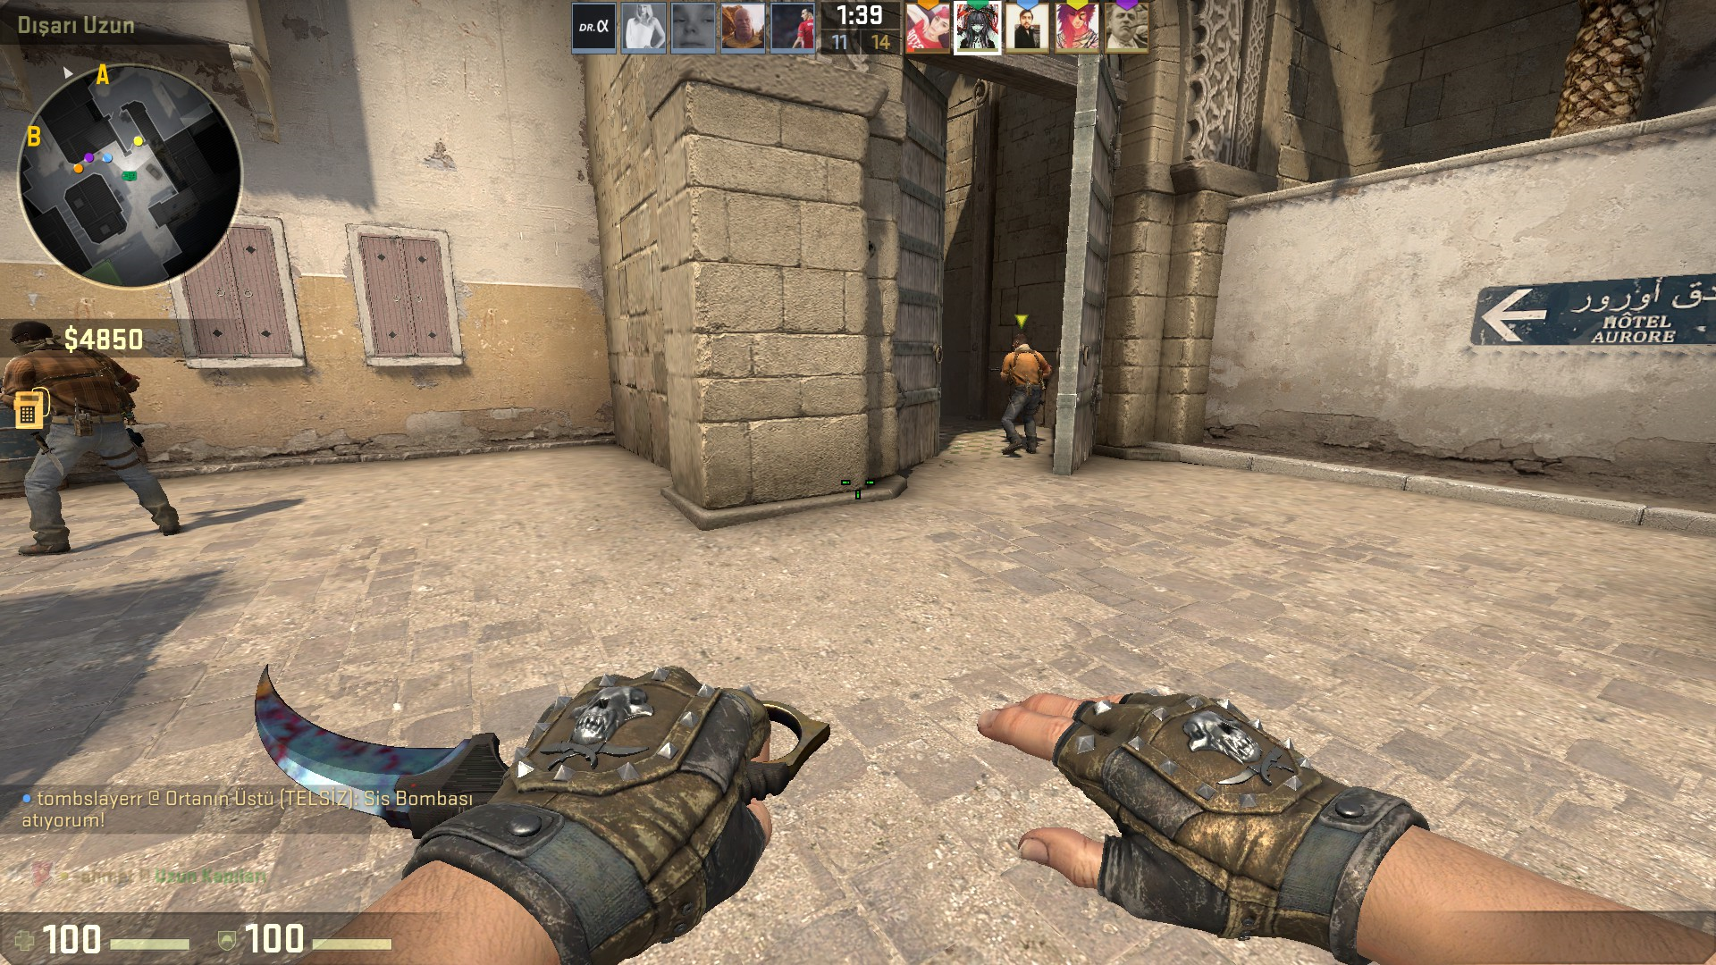
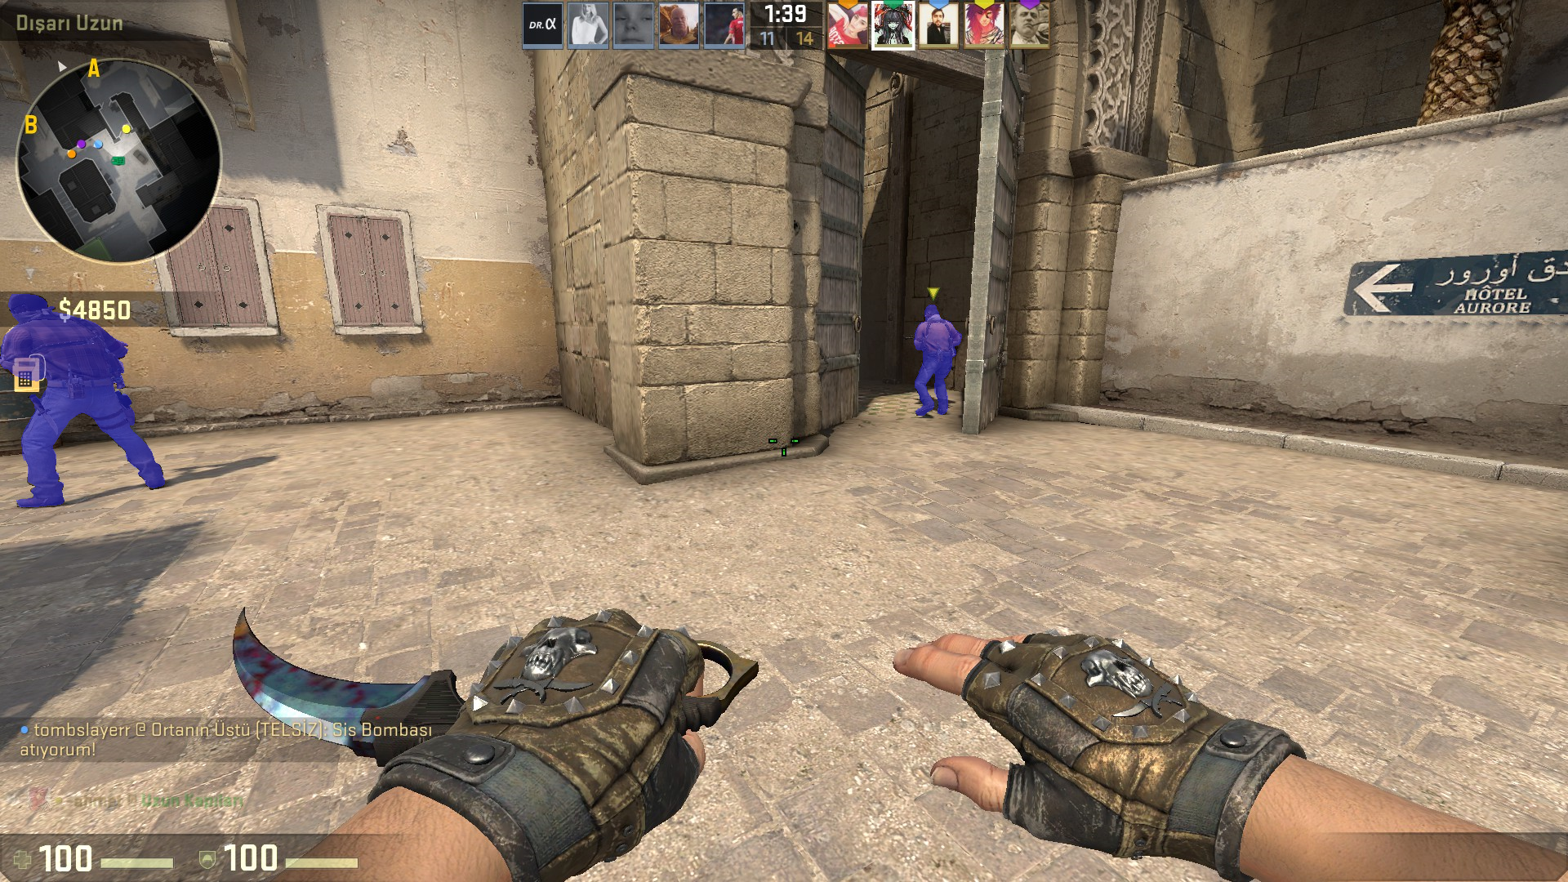
Motivation
Creating a screen aimbot for First person shooter games.
Achieve AI which can aim without reading data from memory

Slide 3
Objectives
Detecting Various Player models in various maps.
Achieving this in real time

Slide 4
Proposed Approach
Steps
1) Resize and blur image
2) Treshold image
3) Segment image
4) Calculate distance from center

Slide 5
Resizing

Slide 6
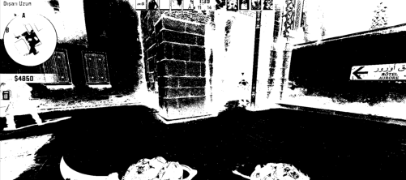
Thresholding

Slide 7
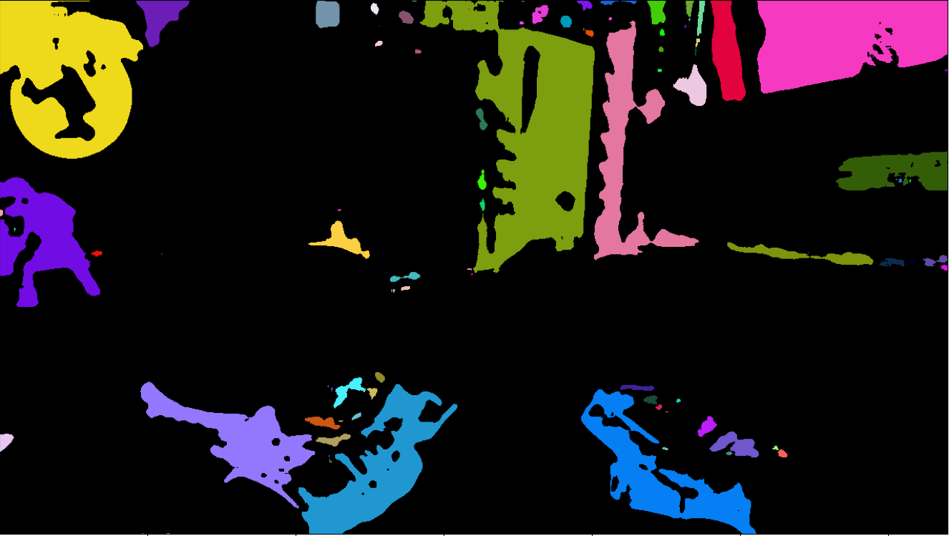
Creating segments

Slide 8
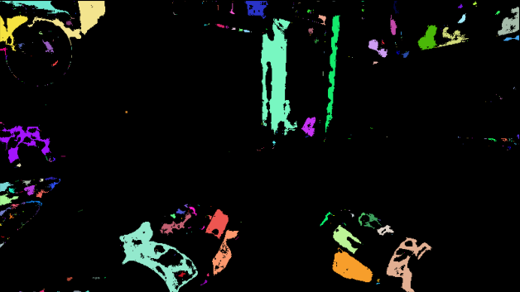
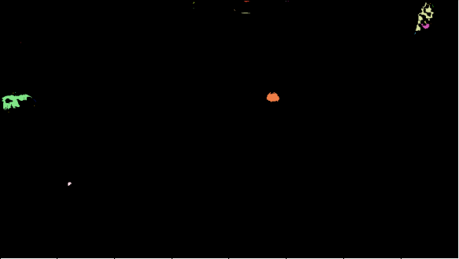
Multiple segments

Slide 9
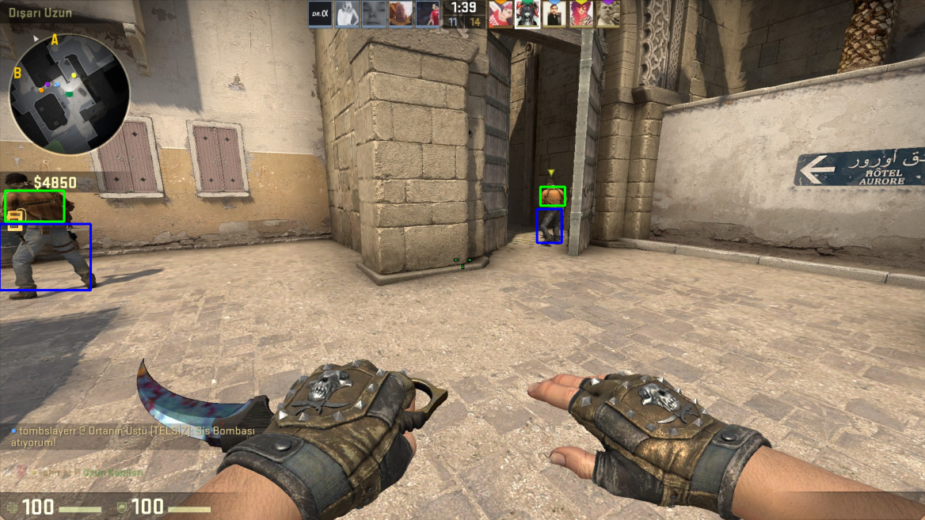
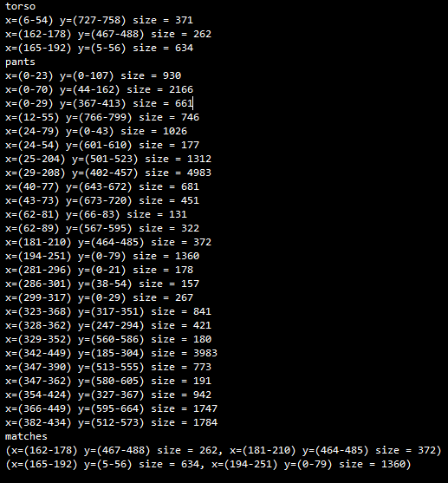
Matching segments

Slide 10
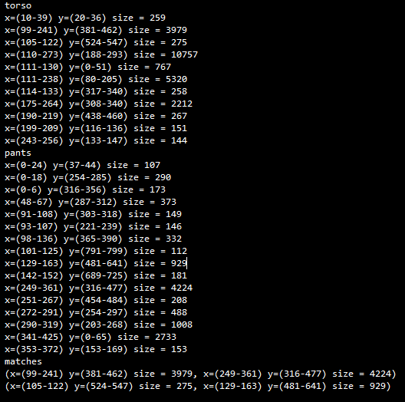
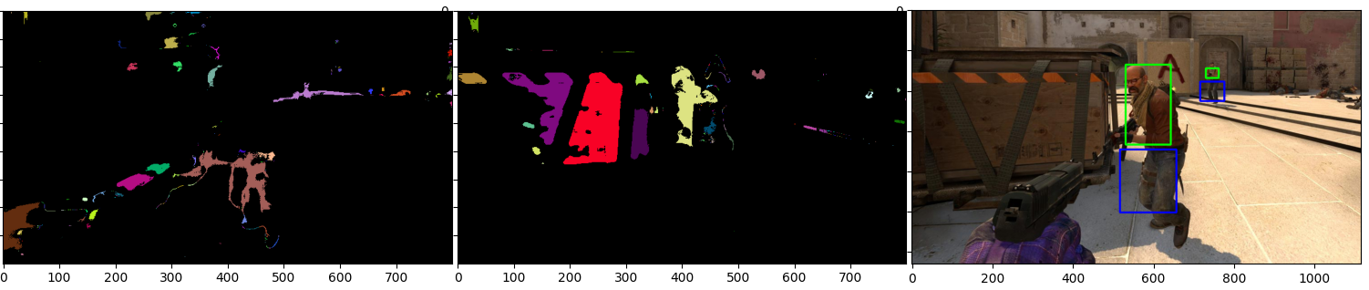
Cutting Corners

Slide 11
Timeline
Detecting Objects ->
Detecting more character models ->
Detecting models from videos ->
Acceleration of code ->
Integration into game (if fast enough)

Slide 12
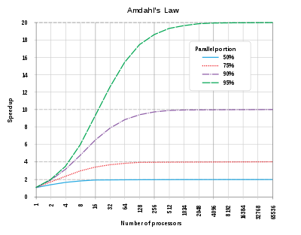
Hardware acceleration
Useful for filtering operations
Not as useful for segmenting

Slide 13
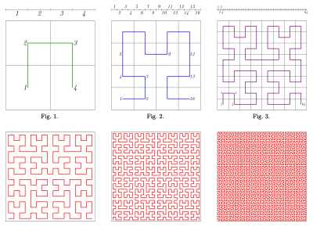
Paramount Cache Accuracy
May be expensive for certain situlations.

